Slide 1
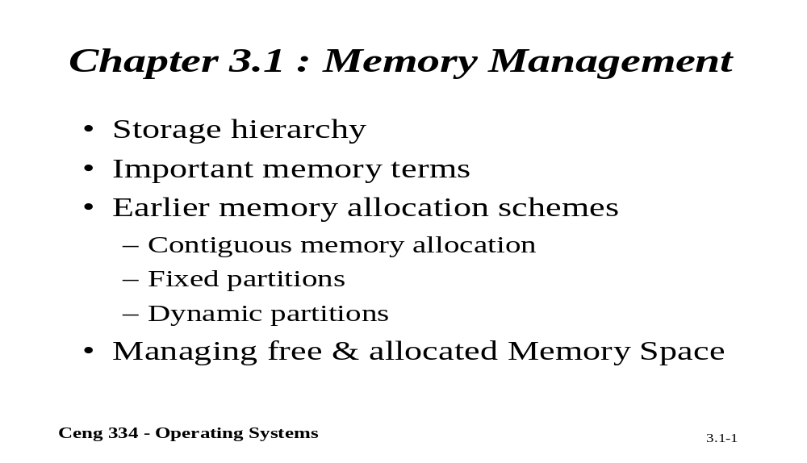
Chapter 3.1: Memory Management

Slide 2
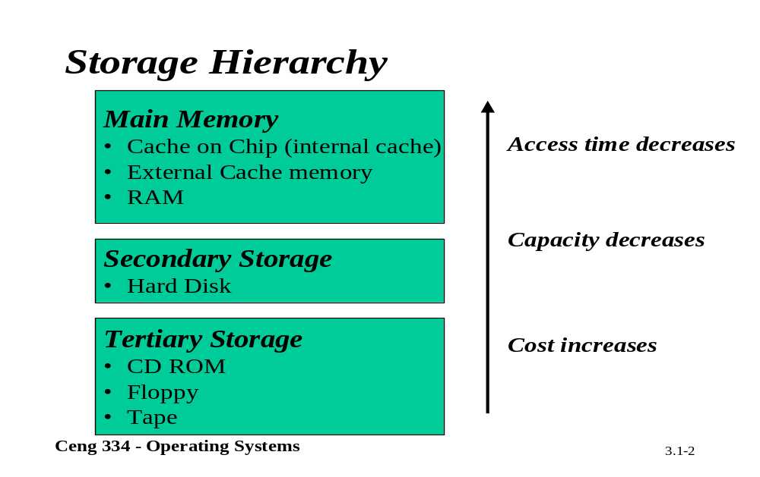
Storage Hierrachy

Slide 3
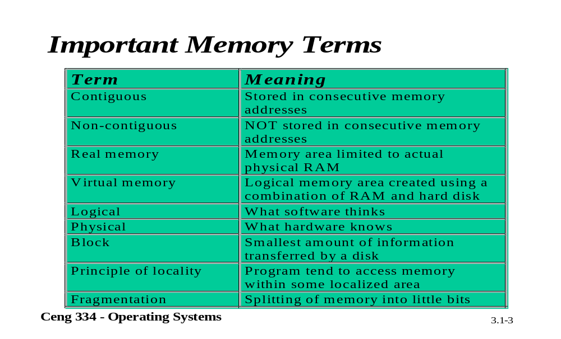
Important Memory Terms

Slide 4
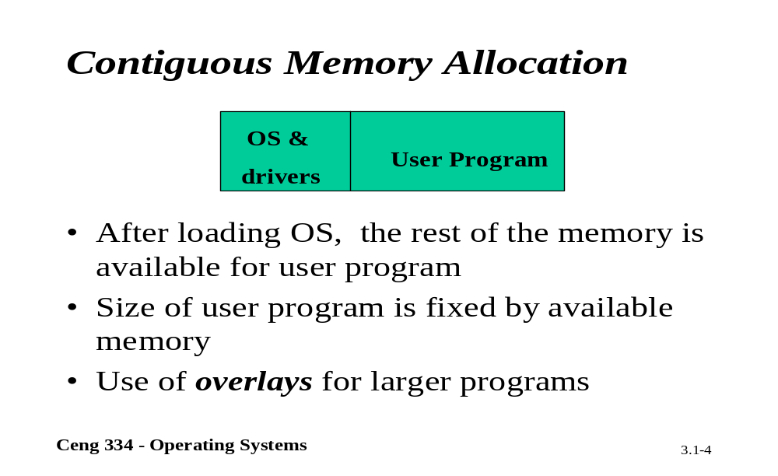
Contiguous Memory Allocation

Slide 5
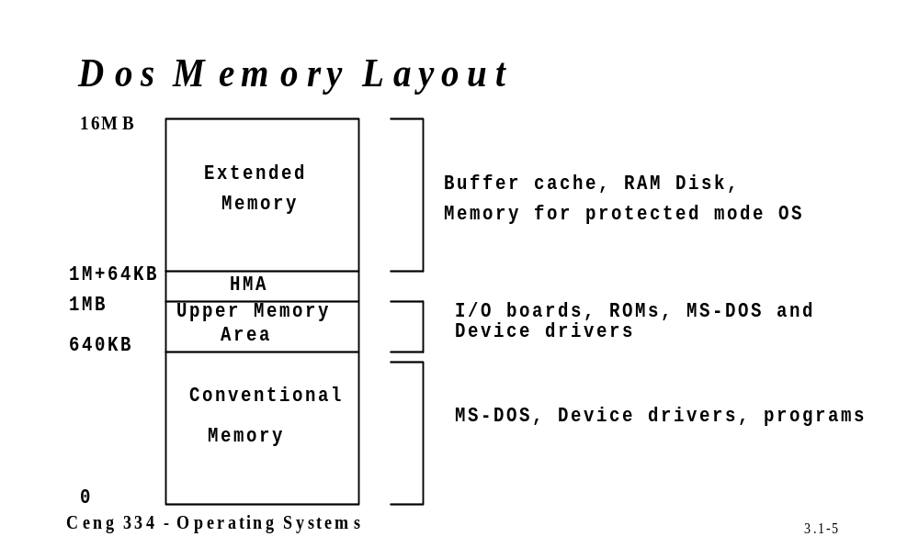
Dos Memory; Memory Map

Slide 6
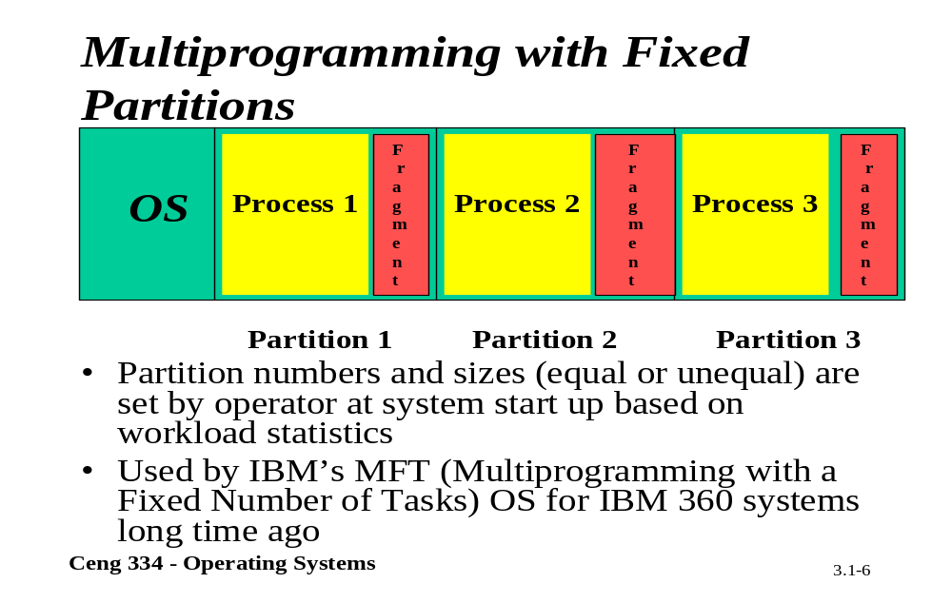
Fixed Partitions

Slide 7
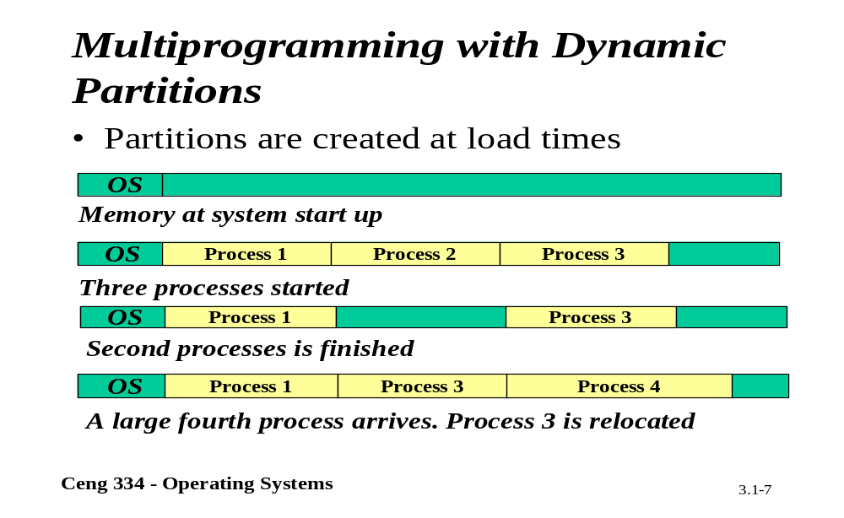
Dynamic Partitions

Slide 8
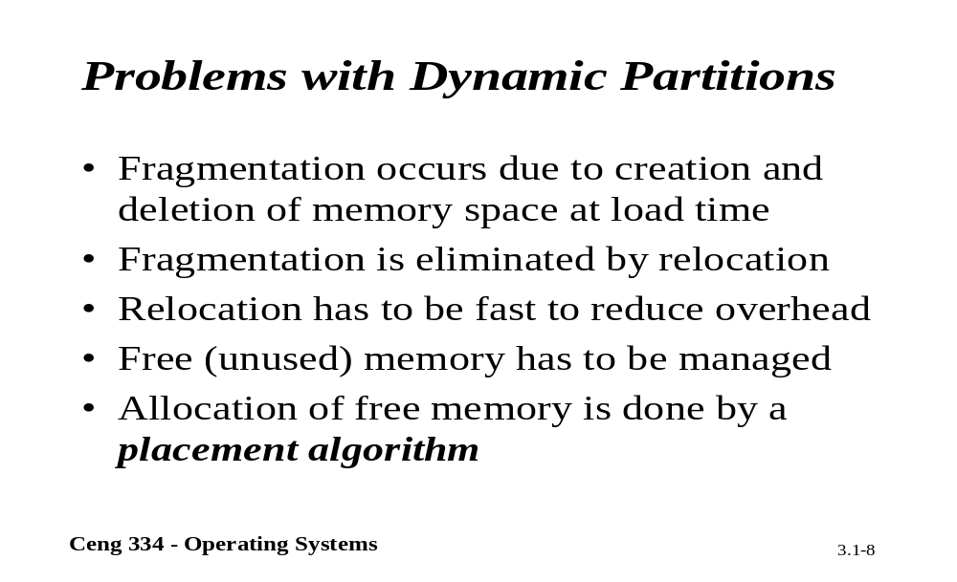
Problems

Slide 9
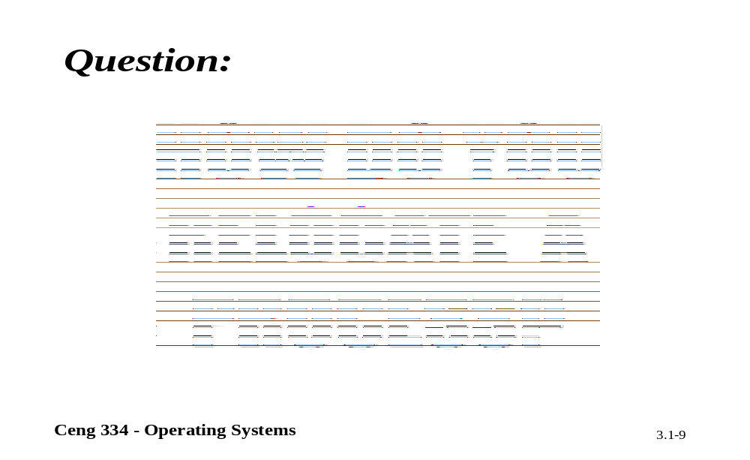
Relocate

Slide 10
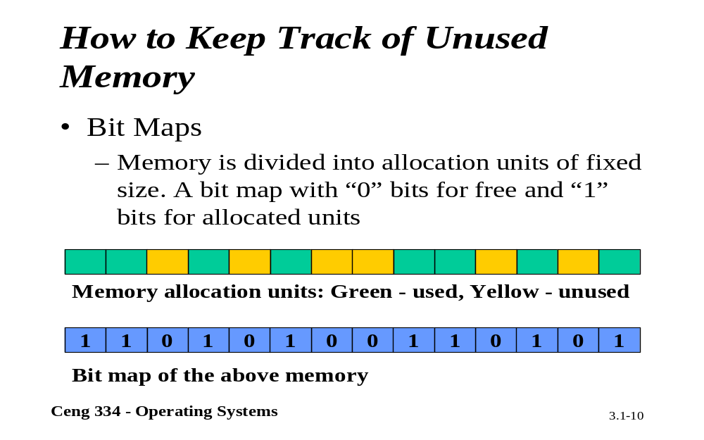
Unused Memory

Slide 11
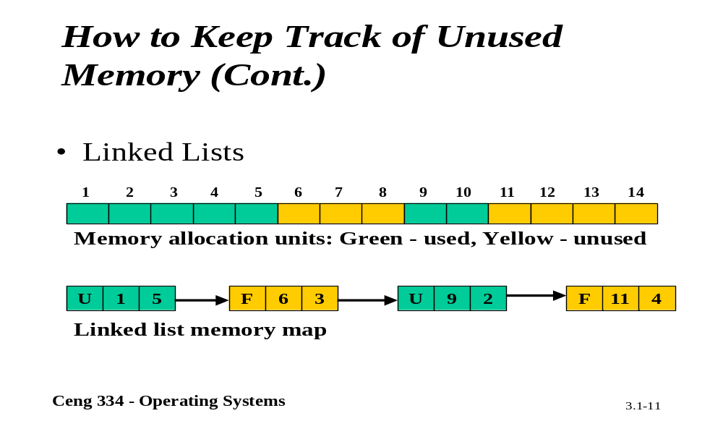
Unused Memory

Slide 12
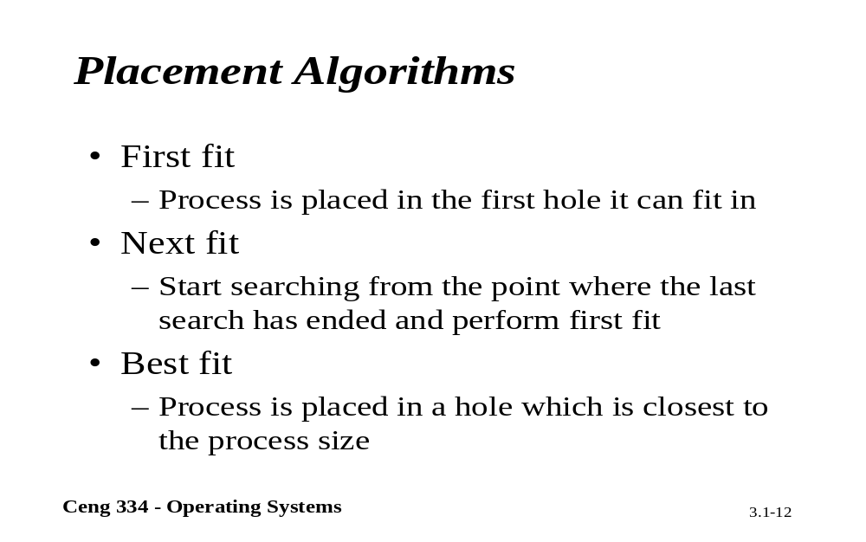
Placement Algorithms

Slide 13
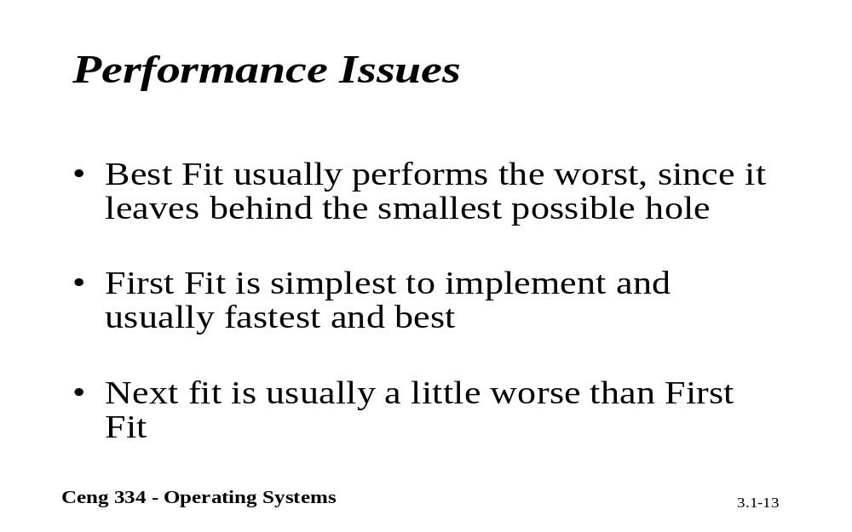
Performance Issues

Slide 14
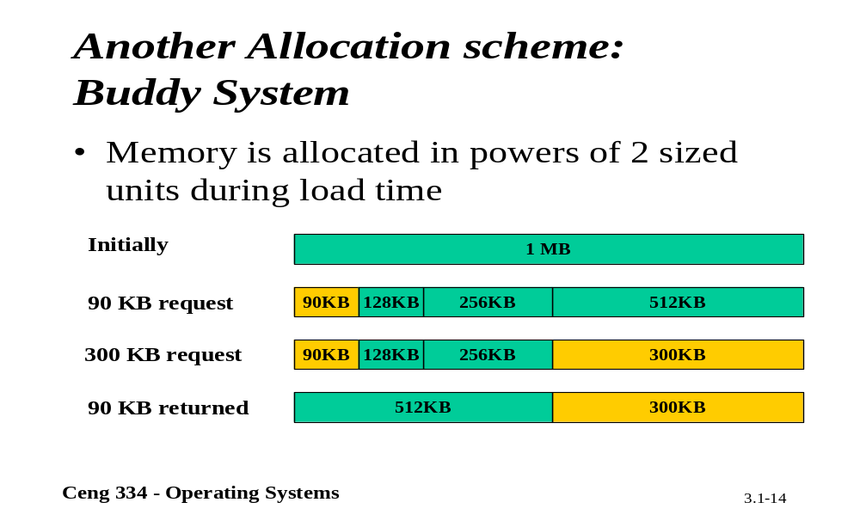
Buddy Ssytem

Slide 15
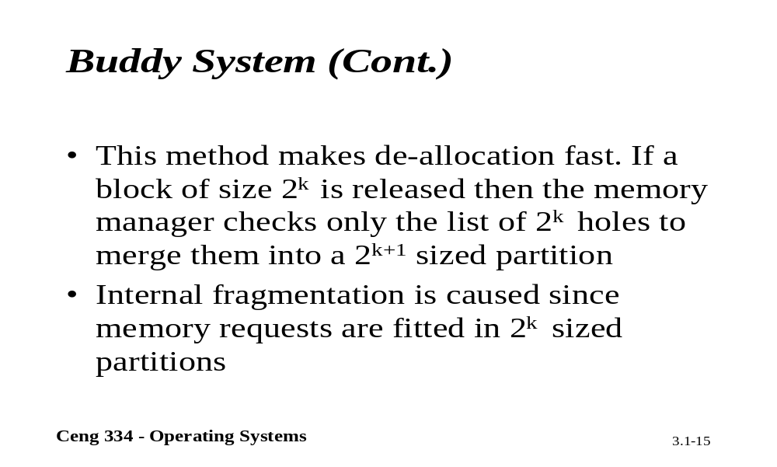
Buddy System

Slide 16
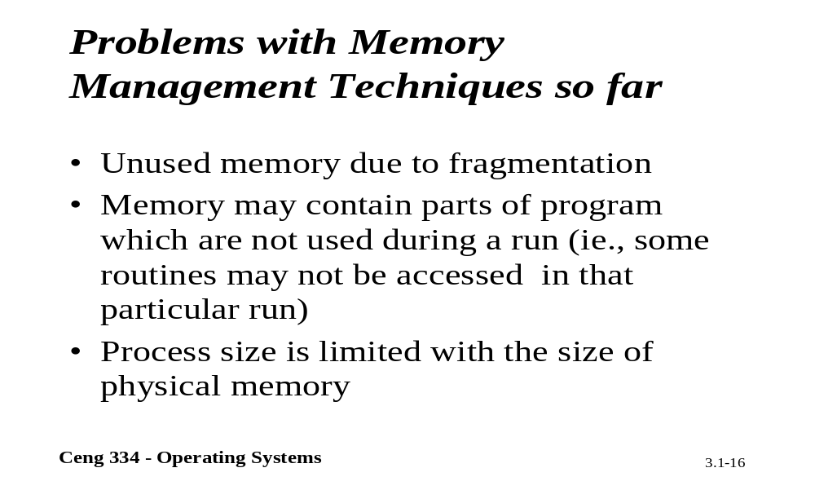
Problems with Memory Mang.

Slide 17
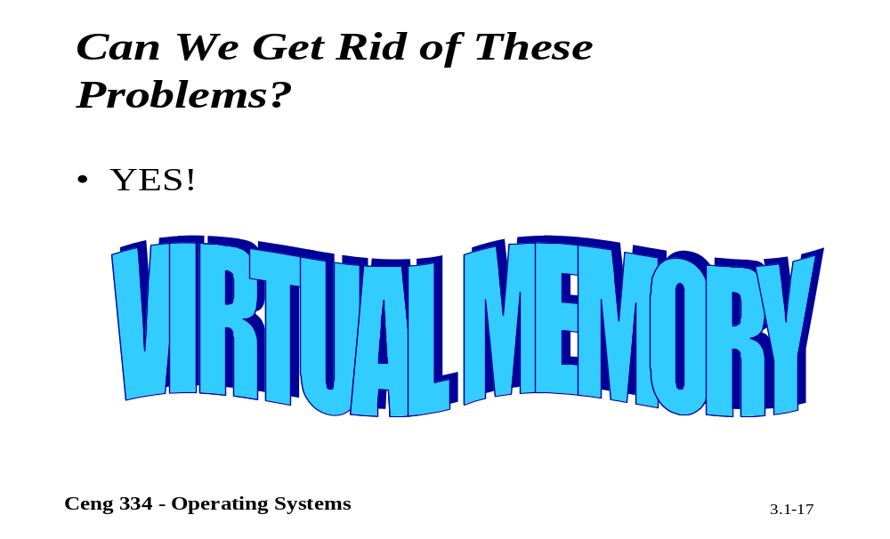
Virtual Memory

